Slide 1
Department of Applied Mathematics and Computational Sciences
III Sem M.Sc.Software Systems
Transform Techniques
Dr. V. Suresh kumar

Slide 2
Fourier Transform

Slide 3
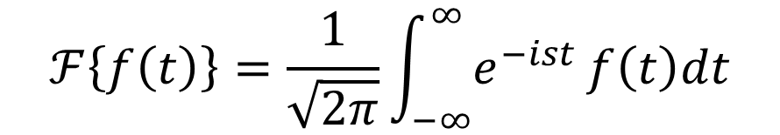
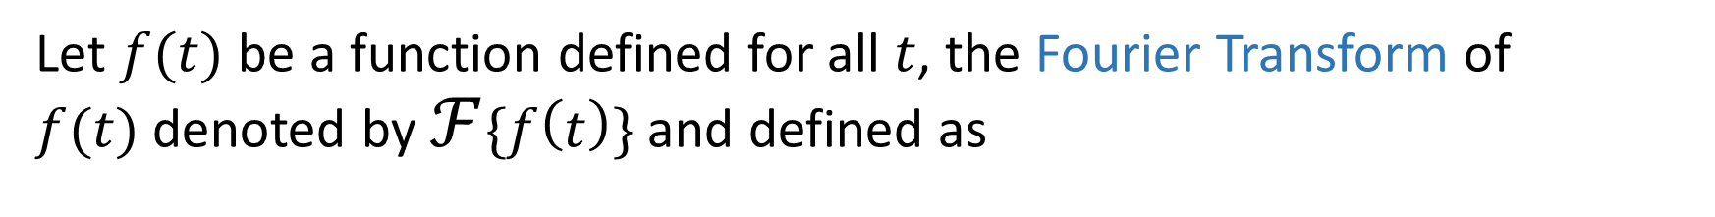
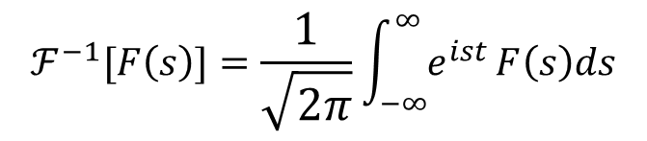

Definition
Let $f(t)$ be a function defined for all $t$, the Fourier Transform of $f(t)$denoted by $ℱ\{f\left(t\right)\}$and defined as
$$ℱ\left\{f\left(t\right)\right\}=\frac{1}{\sqrt{2π}}\int_{−∞}^{∞}{e^{−ist}}f\left(t\right)dt$$
$$ℱ\{f\left(t\right)\}=F(s)$$
Inverse Fourier Transform
$$ℱ^{−1}[F\left(s\right)]=\frac{1}{\sqrt{2π}}\int_{−∞}^{∞}{e^{ist}}F\left(s\right)ds$$

Slide 4
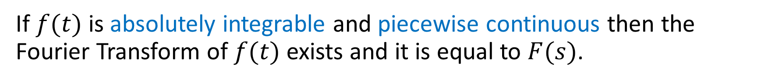
Existence conditions
If $f(t)$ is absolutely integrable and piecewise continuous then the Fourier Transform of $f(t)$ exists and it is equal to $F(s)$.
A function $f(t)$ is said to be absolutely integrable over $(a,b)$if $\int_{a}^{b}{|f\left(t\right)|dt}<∞$

Slide 5
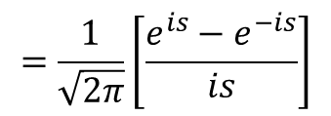
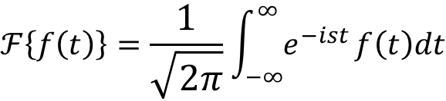
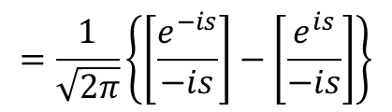

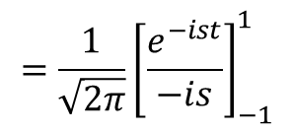
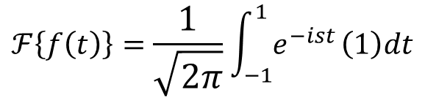
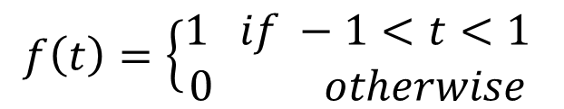
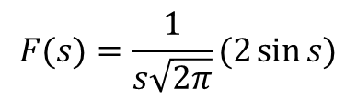
Example
Find the Fourier Transform of $f\left(t\right)=\left\{\begin{aligned}1 if \left|t\right|<1 \\ 0 otherwise\end{aligned} \right.$and hence
compute value of $\int_{0}^{∞}{\frac{\sin{x}}{x}dx}$
Ans:
We have
$$ℱ\left\{f\left(t\right)\right\}=\frac{1}{\sqrt{2π}}\int_{−∞}^{∞}{e^{−ist}}f\left(t\right)dt$$
$$f\left(t\right)=\left\{\begin{aligned}1 if −1<t<1 \\ 0 otherwise\end{aligned} \right.$$
and
$$ℱ\left\{f\left(t\right)\right\}=\frac{1}{\sqrt{2π}}\int_{−1}^{1}{e^{−ist}}\left(1\right)dt$$
$$=\frac{1}{\sqrt{2π}}\left[\frac{{e^{is}−e}^{−is}}{is}\right]$$
$$=\frac{1}{\sqrt{2π}}{\left[\frac{e^{−ist}}{−is}\right]}_{−1}^{1}$$
$$F(s)=\frac{1}{s\sqrt{2π}}(2\sin{s)}$$
$$=\frac{1}{\sqrt{2π}}\left\{\left[\frac{e^{−is}}{−is}\right]−\left[\frac{e^{is}}{−is}\right]\right\}$$

Slide 6
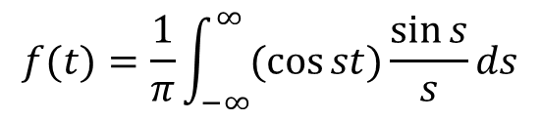
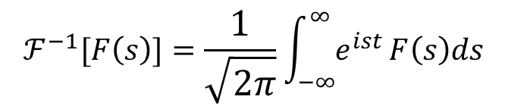

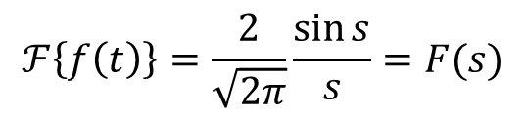
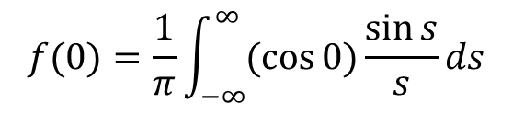

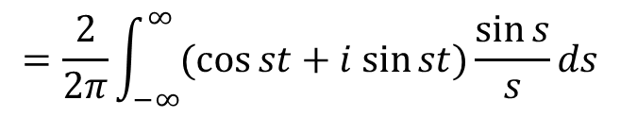
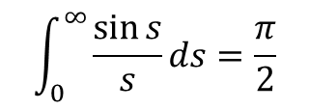
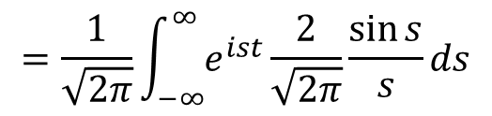
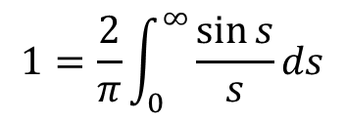
Example cont…
$$ℱ\left\{f\left(t\right)\right\}=\frac{2}{\sqrt{2π}}\frac{\sin{s}}{s}=F(s)$$
Deduction part
Put $t=0$
Using Inverse Fourier Transform
$$f(0)=\frac{1}{π}\int_{−∞}^{∞}{(\cos{0})}\frac{\sin{s}}{s}ds$$
$$ℱ^{−1}[F\left(s\right)]=\frac{1}{\sqrt{2π}}\int_{−∞}^{∞}{e^{ist}}F\left(s\right)ds$$
$$1=\frac{2}{π}\int_{0}^{∞}{\frac{\sin{s}}{s}}ds$$
$$=\frac{1}{\sqrt{2π}}\int_{−∞}^{∞}{e^{ist}}\frac{2}{\sqrt{2π}}\frac{\sin{s}}{s}ds$$
$$\int_{0}^{∞}{\frac{\sin{s}}{s}}ds=\frac{π}{2}$$
$$=\frac{2}{2π}\int_{−∞}^{∞}{(\cos{st}+i sin{st})}\frac{\sin{s}}{s}ds$$
$$f(t)=\frac{1}{π}\int_{−∞}^{∞}{(\cos{st})}\frac{\sin{s}}{s}ds$$
$$\int_{0}^{∞}{\frac{\sin{x}}{x}}dx=\frac{π}{2}$$

Slide 7
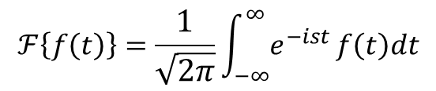
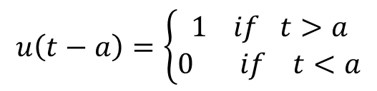
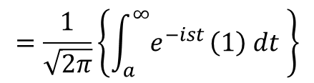
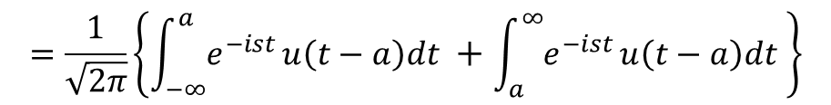
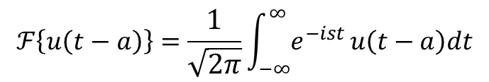
Example cont…
2. Find the Fourier Transform of unit step function and Dirac delta function
Ans:
Unit step function
$$u\left(t−a\right)=\left\{\begin{aligned}1 if t>a \\ 0 if t<a\end{aligned}\right.$$
$$ℱ\left\{f\left(t\right)\right\}=\frac{1}{\sqrt{2π}}\int_{−∞}^{∞}{e^{−ist}}f\left(t\right)dt$$
$$ℱ\left\{u\left(t−a\right)\right\}=\frac{1}{\sqrt{2π}}\int_{−∞}^{∞}{e^{−ist}}u\left(t−a\right)dt$$
$$=\frac{1}{\sqrt{2π}}\left\{\int_{−∞}^{a}{e^{−ist}}u\left(t−a\right)dt +\int_{a}^{∞}{e^{−ist}}u\left(t−a\right)dt \right\}$$
$$=\frac{1}{\sqrt{2π}}\left\{\int_{a}^{∞}{e^{−ist}}\left(1\right) dt \right\}$$

Slide 8
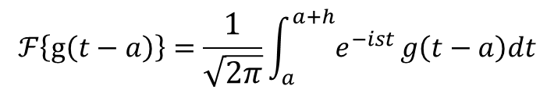
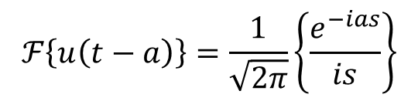
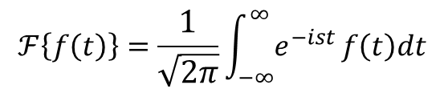
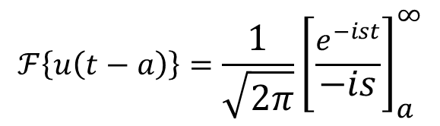
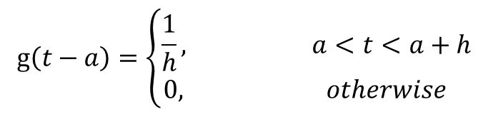

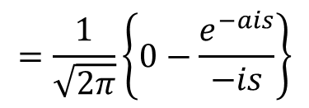
Example cont…
Dirac delta function
$$ℱ\left\{u\left(t−a\right)\right\}=\frac{1}{\sqrt{2π}}{\left[\frac{e^{−ist}}{−is}\right]}_{a}^{∞}$$
$$δ\left(t−a\right)=\lim_{h→0}{g\left(t−a\right)}$$
$$=\frac{1}{\sqrt{2π}}\left\{0−\frac{e^{−ais}}{−is}\right\}$$
$$g\left(t−a\right)=\left\{\begin{aligned}\frac{1}{h}, a<t<a+h \\ 0, otherwise \end{aligned}\right.$$
$$ℱ\left\{u\left(t−a\right)\right\}=\frac{1}{\sqrt{2π}}\left\{\frac{e^{−ias}}{is}\right\}$$
$$ℱ\left\{f\left(t\right)\right\}=\frac{1}{\sqrt{2π}}\int_{−∞}^{∞}{e^{−ist}}f\left(t\right)dt$$
$$ℱ\left\{g\left(t−a\right)\right\}=\frac{1}{\sqrt{2π}}\int_{a}^{a+h}{e^{−ist}}g\left(t−a\right)dt$$

Slide 9

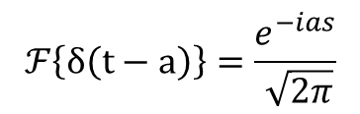
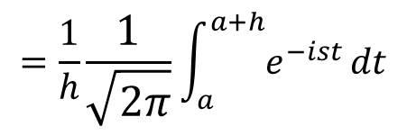
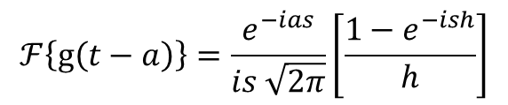
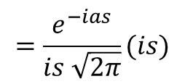
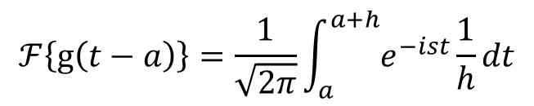
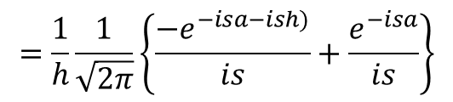
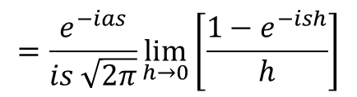
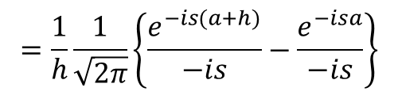
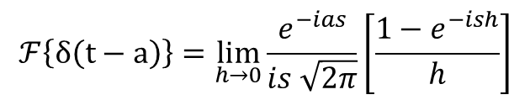
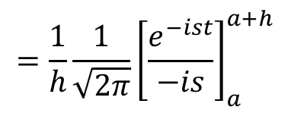

Example cont…
$$ℱ\left\{g\left(t−a\right)\right\}=\frac{1}{\sqrt{2π}}\int_{a}^{a+h}{e^{−ist}}\frac{1}{h}dt$$
$$ℱ\left\{g\left(t−a\right)\right\}=\frac{e^{−ias}}{is \sqrt{2π}}\left[\frac{1−e^{−ish}}{h}\right]$$
$$=\frac{1}{h}\frac{1}{\sqrt{2π}}\int_{a}^{a+h}{e^{−ist}}dt$$
$$δ\left(t−a\right)=\lim_{h→0}{g\left(t−a\right)}$$
$$ℱ\left\{δ\left(t−a\right)\right\}=\frac{e^{−ias}}{ \sqrt{2π}}$$
$$=\frac{1}{h}\frac{1}{\sqrt{2π}}{\left[\frac{e^{−ist}}{−is}\right]}_{a}^{a+h}$$
$$ℱ\left\{δ\left(t−a\right)\right\}=\lim_{h→0} ℱ\left\{g\left(t−a\right)\right\}$$
$$ℱ\left\{δ\left(t−a\right)\right\}=\lim_{h→0}\frac{e^{−ias}}{is \sqrt{2π}}\left[\frac{1−e^{−ish}}{h}\right]$$
$$=\frac{1}{h}\frac{1}{\sqrt{2π}}\left\{\frac{e^{−is(a+h)}}{−is}−\frac{e^{−isa}}{−is}\right\}$$
$$=\frac{e^{−ias}}{is \sqrt{2π}}\lim_{h→0}\left[\frac{1−e^{−ish}}{h}\right]$$
$$=\frac{1}{h}\frac{1}{\sqrt{2π}}\left\{\frac{{−e}^{−isa−ish)}}{is}+\frac{e^{−isa}}{is}\right\}$$
$$=\frac{e^{−ias}}{is \sqrt{2π}}(is)$$

Slide 10


